Slide 1
WELCOME

Slide 2


Slide 3
Flight Operation Hub
Developed by:- Abhi Gupta
Omkar Katore
Project Guide:- Dr . Kamlesh Meshram Sir
Project Mentor:- Sanjay Dandle Sir
Presentation by:- Abhi Gupta
Omkar Katore

Slide 4

CONTENTS
INTRODUCTION
OBJECTIVES
METHODOLOGY
FUTURE SCOPE

Slide 5

CONTENTS
INTRODUCTION
OBJECTIVES
METHODOLOGY
FUTURE SCOPE

Slide 6

CONTENTS
INTRODUCTION
OBJECTIVES
METHODOLOGY
FUTURE SCOPE

Slide 7

CONTENTS
INTRODUCTION
OBJECTIVES
METHODOLOGY
FUTURE SCOPE

Slide 8
The Flight Operation Hub aims to provide a real-time and automated solution for airline operations, including ticket booking, flight scheduling, passenger management, and cancellations. This system will help airlines streamline their operations, reduce manual workload, and enhance customer experience by providing a simple, efficient, and secure way to manage airline services.
With the increasing number of air travelers, airlines require a robust and scalable system that can handle bookings, cancellations, and flight status management effectively. This project will ensure that passengers and administrators have a seamless experience in managing airline operations.
INTRODUCTION

Slide 9
OBJECTIVES
To develop a fully automated Flight Operation Hub that simplifies booking, cancellations, and passenger management.
To integrate real-time flight scheduling and status updates for passengers and administrators.
To ensure seamless payment processing through multiple online payment gateways.
To generate reports for airline operators, including financial summaries, flight occupancy, and operational insights

Slide 10
METHODOLOGY
Approach
Tools
Techniques
Technology

Slide 11
METHODOLOGY
Requirement Analysis:- Gathering user and system requirements from airline operations.
Design:-
Creating system architecture, ER diagrams, use case models, and wireframes.
Implementation:-
Developing modules like flight management, booking, and authentication
Testing:- Unit testing, integration testing, and user acceptance testing.
Deployment:- Installation and execution in a real-world or demo environment.
Maintenance:- Continuous feedback loop for future enhancements.
Tools
Approach
Techniques
Technology

Slide 12
METHODOLOGY
Approach
Development Eclipse:-
Used to write, debug, and compile code efficiently for desktop or mobile applications.
UI Design / Prototyping Draw.io:-
Used to create wireframes, mockups, and system diagrams (e.g., ER, flowcharts).
Database Management MySQL Workbench, phpMyAdmin:-
Helps design, manage, and interact with the database through a graphical interface.
Tools
Techniques
Technology

Slide 13
Object-Oriented Programming (OOP):-
Used to build the system using classes and objects for better modularity, reusability, and scalability
Model-View-Controller (MVC):-
Organizes the code into layers (Model, View, Controller) to separate UI, logic, and data handling for clean architecture.
Encryption & Authentication:-
Protects sensitive data and restricts system access to authorized users only.
Agile Principles:-
Enables flexible and adaptive development through short cycles and continuous feedback.
METHODOLOGY
Approach
Tools
Techniques
Technology

Slide 14
METHODOLOGY
Approach
Front-End Java (Desktop UI):- The Used to create interactive and user-friendly interfaces for both web and desktop users.
Database MySQL:-
Stores all flight, booking, passenger, and payment information in a structured format. Firebase Can be used for cloud messaging and real-time location tracking.
Deployment:-
Local server / Cloud hosting (optional) Hosts the application for real-time access either locally or via a cloud platform.
Tools
Technology
Techniques

Slide 15

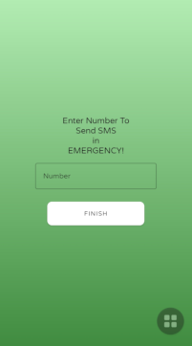
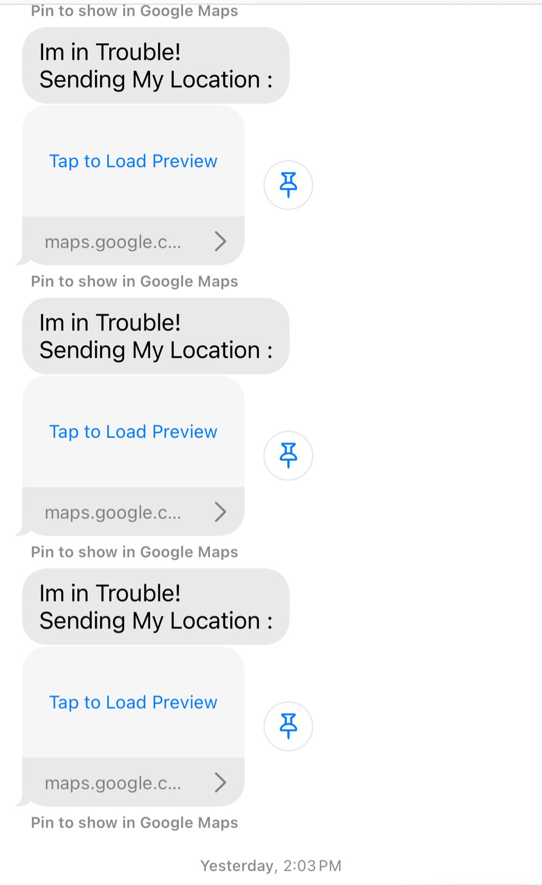
UI Images
Starting page
Home Page
Message alert

Slide 16
Future Scope
AI-Based Pricing Optimization:-
Implement machine learning models to analyze demand, seasonality, and competitor pricing for dynamic ticket pricing.
Cloud Integration:-
Migrate the system to a cloud-based platform for better scalability, availability, and real-time data synchronization across multiple locations.
Mobile Application Support:-
Develop a mobile app for passengers to book tickets, track flights, and receive notifications.
Blockchain for Secure Transactions:-
Implement blockchain-based ticketing and payment systems to enhance security and transparency in transactions.
Enhanced Passenger Experience with AI Chatbots:-
Introduce AI-powered virtual assistants to handle customer queries, booking assistance, and flight status updates.
IoT-Based Smart Airport Integration:-
Connect with IoT devices at airports for real-time baggage tracking, automated check-ins, and improved passenger navigation.

Slide 17
Conclusion
The Flight Operation Hub is a smart, automated system designed to simplify airline operations like booking, scheduling, cancellations, and secure payments. It reduces manual work, improves efficiency, and enhances user experience for both passengers and airline staff. With future enhancements like AI-based pricing, cloud support, mobile apps, and biometric security, this project can evolve into a comprehensive, next-gen airline management platform—offering innovation, scalability, and reliability.

Slide 18
Thank you

